Slide 1



Capstone Project: Predicting Customer Churn
This capstone project aims to develop a robust machine learning model that can accurately predict which customers are likely to churn, or stop using the company's services, in the future. By identifying potential churn, the company can proactively implement strategies to retain these customers and maintain a healthy, growing customer base.
Created & Edited By - Akshat Upadhyaya

Slide 2

Business Understanding and Problem Statement
1
Business Objective
2
Problem Statement
Customer churn is a significant problem for large companies, especially in the telecom industry, as it directly affects revenue, increases customer acquisition costs, and negatively impacts growth. Companies need to identify customers likely to churn in the near future to take timely action and prevent it.
The task is to build a suitable machine learning model that can predict which customers are likely to churn, or stop using the company's services, in the future. This will enable the company to implement targeted strategies to retain these customers and maintain a healthy, growing customer base.

Slide 3

Client Requirements
Technical Requirements
Data Validation
The client requires the use of a Windows system, Jupyter Notebook, and Microsoft Excel to work on the project. The client will be provided with the Jupyter Notebook containing the developed solution.
The client needs to check if the new dataset has any null values(if yes then treat them) and if the dataset is balanced or not(if not then balance it). If these conditions are met, the client can simply load the dataset into the provided code to run the analysis.

Slide 4
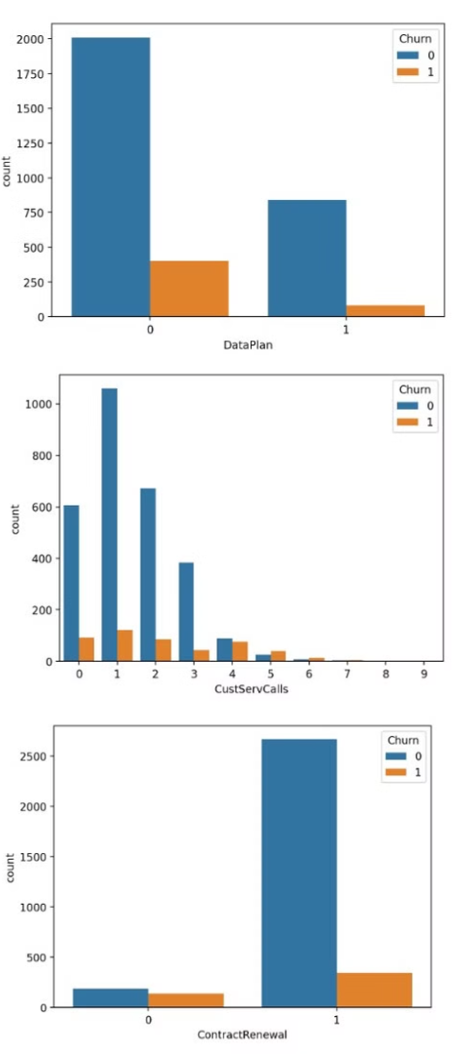
Valuable Insights
1
Correlation Matrix
The analysis revealed that the features Contract Renewal, CustServCalls, and DayMins have the highest correlation with the target variable, Churn, suggesting these are important predictors of customer churn.
2
Data Plan vs. Churn
The histogram shows that 20% of customers who did not opt for the data plan churned, while only 10% of customers who took the plan churned, indicating that the data plan pricing may be perceived as expensive.
3
Customer Service Calls vs. Churn
The churn rate increases sharply for customers who have 4 or more customer service calls, suggesting that the quality of customer service may be a significant factor in customer retention.
4
Histogram of Contract Renewal VS Churn:
The churn rate is much higher when the contract is not renewed, indicating a potential cause for churn.

Slide 5
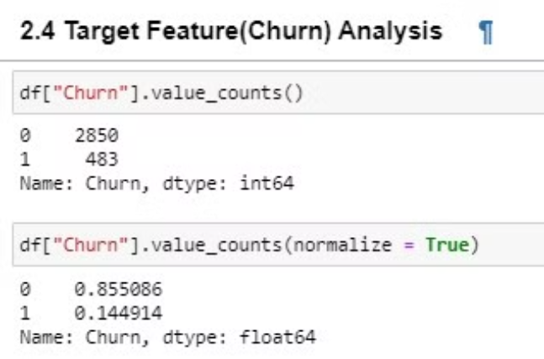
Target Feature Analysis
Data Imbalance
Sampling Technique
The analysis revealed a significant data imbalance, with 85.5% of the data belonging to the "no churn" class (0) and only 14.5% belonging to the "churn" class (1). This imbalance needs to be addressed during the data pre-processing stage to ensure the machine learning model learns effectively from the minority class.
To address the data imbalance, the team employed the SMOTE (Synthetic Minority Over-sampling Technique) sampling method. This technique generates synthetic samples of the minority class, reducing the complexity and increasing the learning ability of the machine learning model.

Slide 6
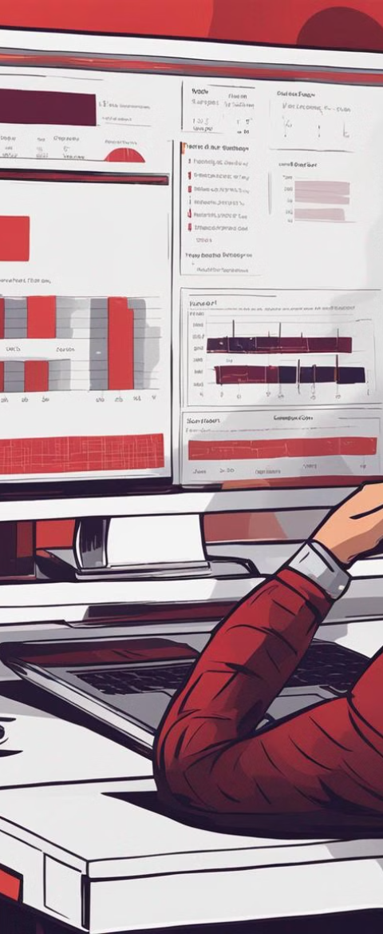
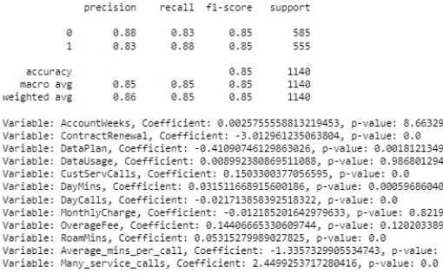
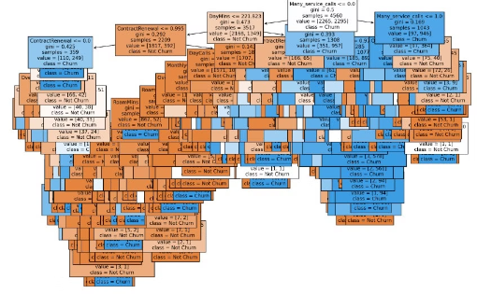
Model Selection
Logistic Regression
The logistic regression model provided insights into the significance of various predictor variables, as evidenced by the beta coefficients and p-values.
Decision Tree
The decision tree model was also evaluated, and the resulting rules or decision tree structure were reviewed to understand the key factors contributing to customer churn.

Slide 7
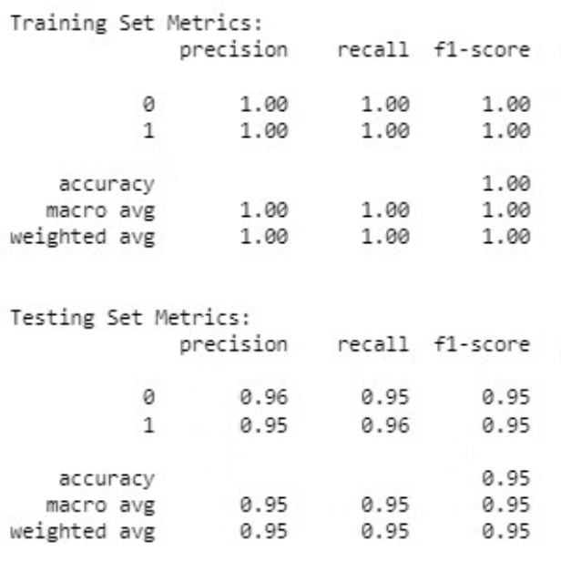
Random Forest Results
Best Performing Model
After evaluating multiple models, the team determined that the Random Forest classifier provided the best performance in terms of precision, recall, F1-score, and overall accuracy of 96%. This model was selected as the final solution for predicting customer churn.

Slide 8
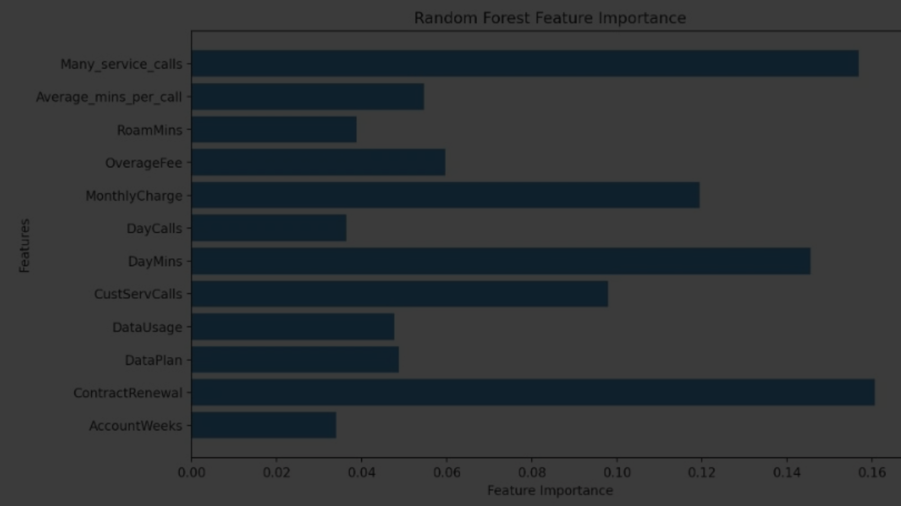




Significant Variables
Many Service Calls
Day Minutes
Contract Renewal
Monthly Charge
The number of customer service calls was identified as a significant predictor of churn, with customers making more than 3 calls being more likely to churn.
The total number of minutes used by the customer during the day was also a significant factor in predicting churn.
Whether the customer renewed their contract or not was a strong indicator of their likelihood to churn.
The monthly charge paid by the customer was also found to be a significant predictor of churn.

Slide 9
Conclusion and Recommendations
Review Data Plan Pricing
Improve Customer Service
The analysis suggests that the high churn rate among customers who did not opt for the data plan may be due to the perceived expensiveness of the plan. The company should consider reviewing and adjusting its pricing strategy to make the data plans more attractive and competitive.
The sharp increase in churn rate after 4 or more customer service calls indicates that customers may be dissatisfied with the level of support they are receiving. The company should focus on improving the quality of customer service, investing in better training for representatives, streamlining processes, and offering more personalized support.
Encourage Contract Renewals
Personalized Retention Offers
Since churn rates are higher when contracts are not renewed, the company should implement strategies to encourage customers to renew their contracts, such as offering incentives, discounts, or loyalty rewards.
The company should leverage customer data to create personalized retention offers for at-risk customers, tailoring promotions, discounts, or special deals to their specific needs and preferences.

